Slide 1
Image Analysis And Translation
팀: 손홈/201910579
상매/201910578

Slide 2

1
Project introduction
목
차
2
Ocr/text translate create
CONTENTS
3
Building code and page design
4
Result analysis

Slide 3



웹 앱
비즈니스와 함께 규모가 조정되는 웹 앱
모바일 앱
모든 디바이스에 대한 모바일 앱 빌드
기능
개발을 가속화하는 serverless 이벤트 기반 경험
논리 앱
SaaS와 온-프레미스를 가로지르는 비즈니스 프로세스 자동화
API 앱
클라우드 내에서 API를 쉽게 빌드하고 소비
Notes:
Function App 은 뒷 시간에 마이크로서비스에 대해서 설명하실 다른 분께서 잘 해주실 것 같구요.
저는 WebApp에 대해서 조금 설명 드리려고 합니다.

Slide 4


unload
게시
deployment
call
call
web
PC
link
Web
ocr text translate
services
obtain
C#

Slide 5
1.
Project introduction
Microsoft Cognitive Services include five fields: image, voice, language, search and knowledge. Through the independent or combined use of these cognitive services, many real world problems can be solved.
The content of our project is to use Microsoft Cognitive Service OCR and text translate to translate the pictures into the language we want to translate. Our project is to translate English or Japanese into Chinese.

Slide 6
2.
Ocr/text translate create
OCR (Optical Character Recognition) service can recognize all the characters on the picture
Text Translate( Text Translation) can translate
Japanese or English into Chinese.

Slide 7
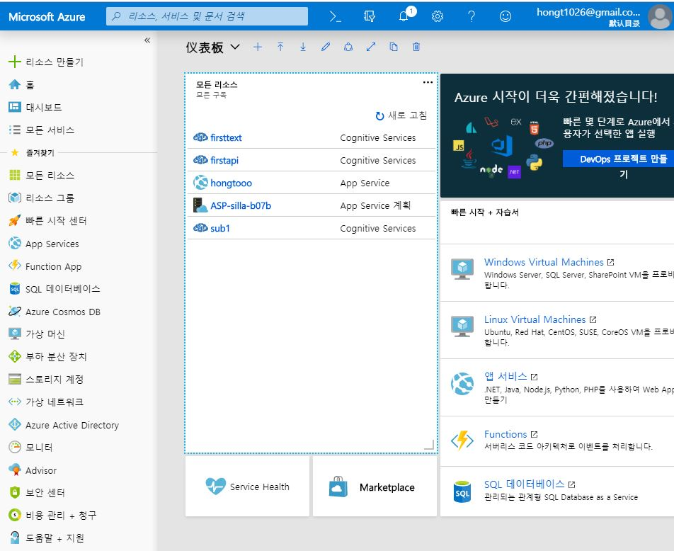
ocr and text translate create on mircrosoft azure

Slide 8
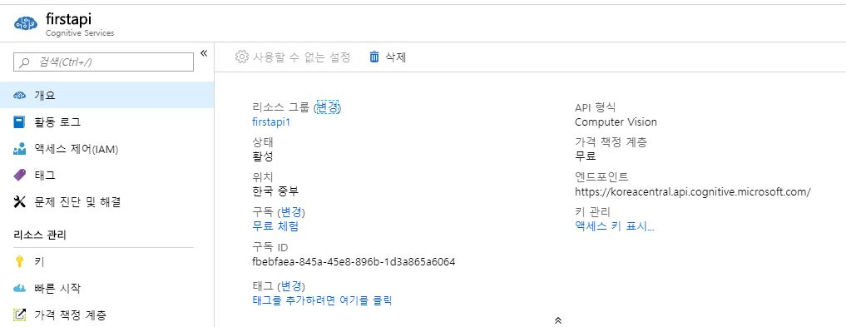
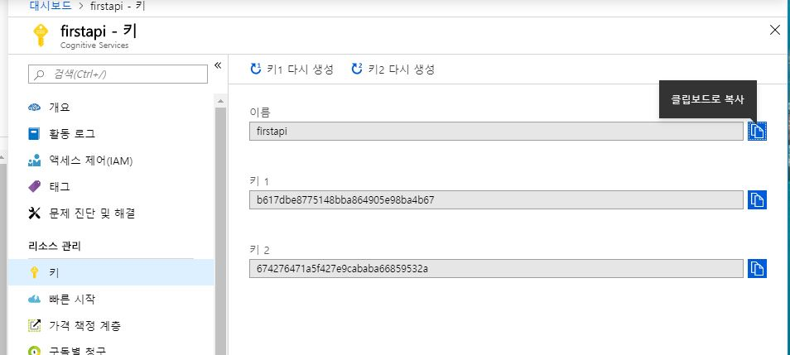
Application for OCR Service Key

Slide 9
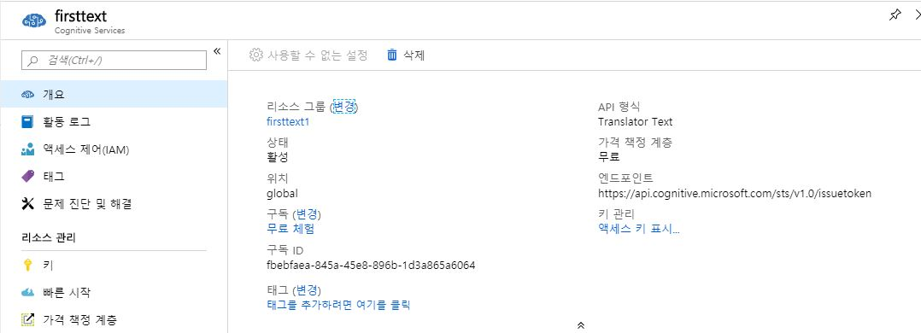
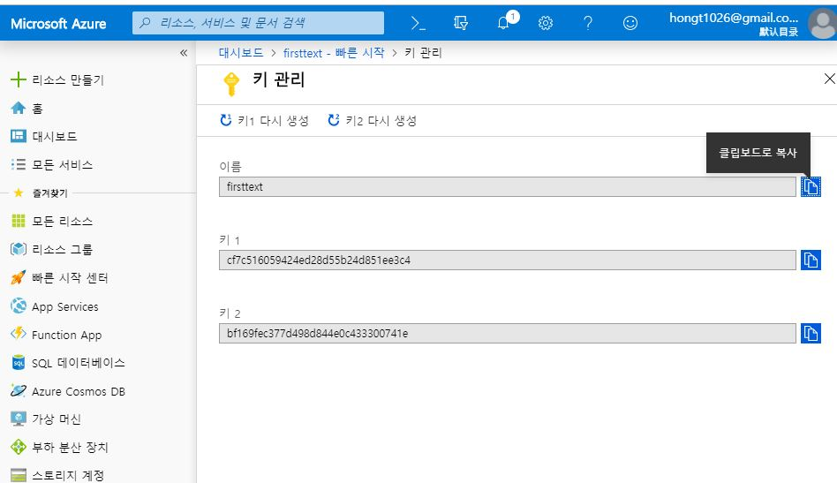
2.Application for Text Translate Text Translation Service Key

Slide 10
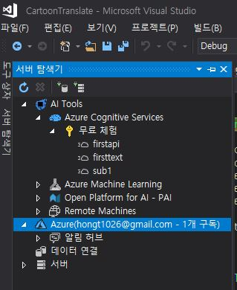
3.Installation Microsoft Visual Studio Tools for AI
on Visual Studio 2017 Community

Slide 11
3.
Building code and page design
1.Building code
Display result test
Design and adjust pages
Display result test
API call
Processing returned data

Slide 12
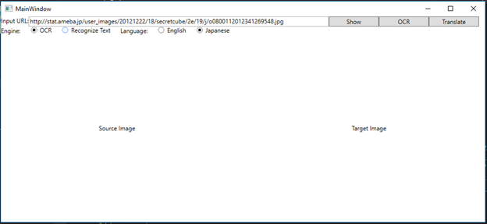
2.page design
Input URL: The URL used to enter a picture on the Internet
Engine: two different algorithm engines
Show: Show the image in the Input URL to the following image area
OCR: Call the OCR service
Translate: Call the text translation service to translate
Japanese or English into Chinese
Language: To develop the language of cartoons to be translated,
we only take English and Japanese as examples.
Source Image: The original picture Target Image: Pictures translated into Chinese

Slide 13
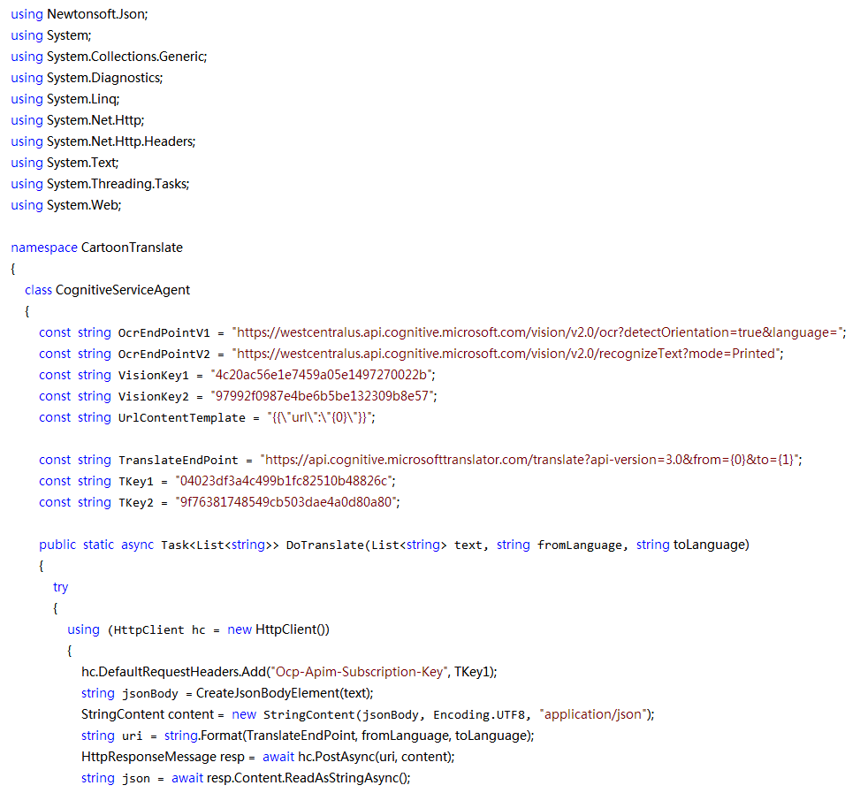
API Cognitive Service code
Firstocr
firsttext
https://westus.dev.cognitive.microsoft.com/docs/services/5adf991815e1060e6355ad44/operations/56f91f2e778daf14a499e1fc

Slide 14
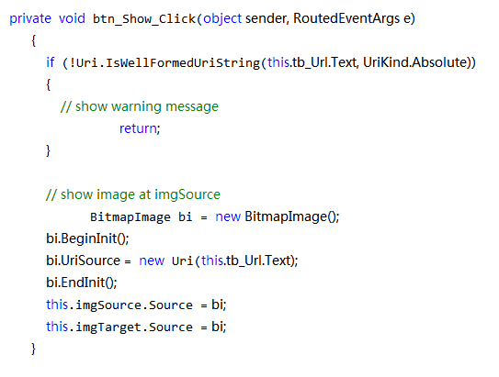
Show button click code

Slide 15
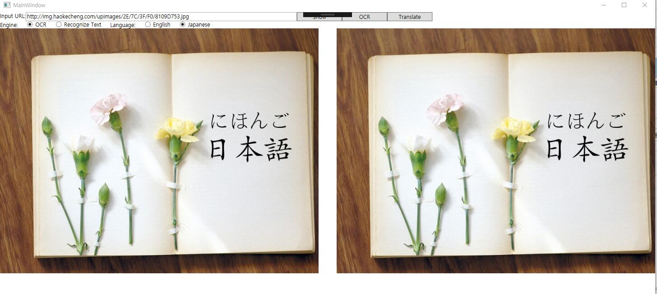
SHOW BUTTON

Slide 16
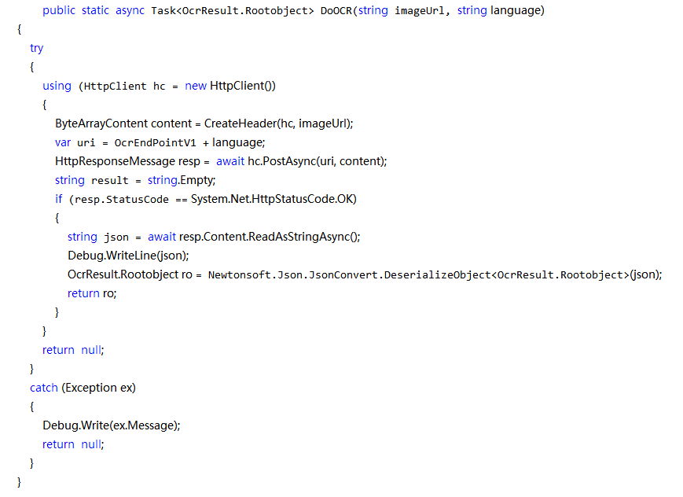
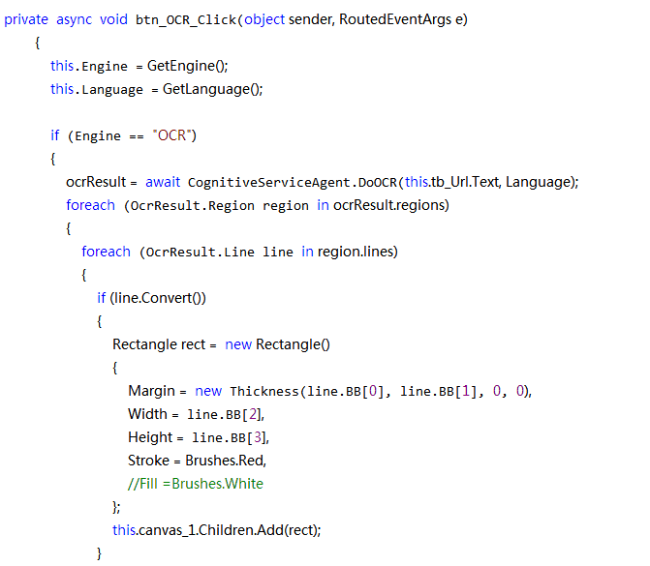
OCR button click code
REST API

Slide 17
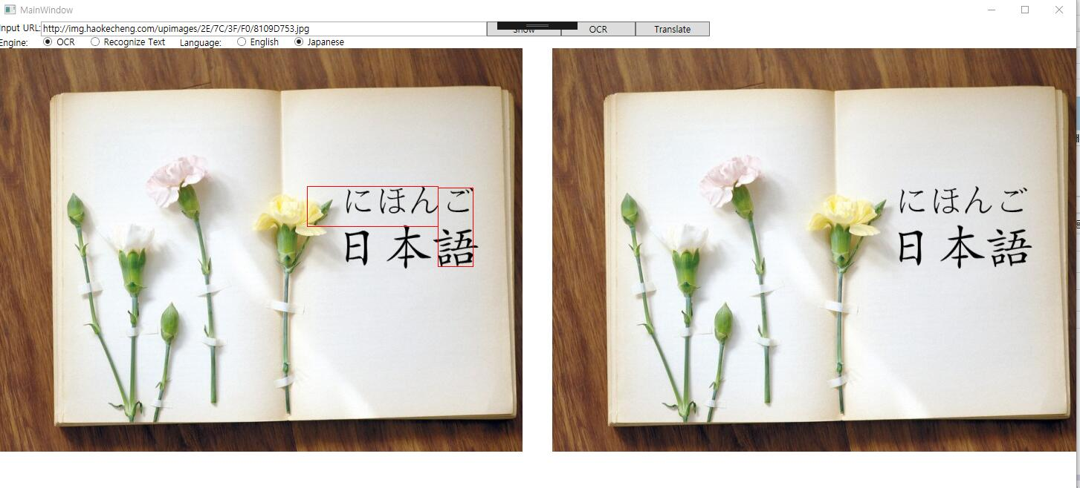
OCR BUTTON

Slide 18
translate button click code
private async void btn_Translate_Click(object sender, RoutedEventArgs e)
{
List<string> listTarget = await this.Translate();
this.ShowTargetText(listTarget);
}
private async Task<List<string>> Translate()
{
List<string> listSource = new List<string>();
List<string> listTarget = new List<string>();
if (this.Version == "OCR")
{
foreach (OcrResult.Region region in ocrResult.regions)
{
foreach (OcrResult.Line line in region.lines)
{
listSource.Add(line.TEXT);
if (listSource.Count >= 25)
{
List<string> listOutput = await CognitiveServiceAgent.DoTranslate(listSource, Language, "zh-Hans");
listTarget.AddRange(listOutput);
listSource.Clear();
}
}
}

Slide 19
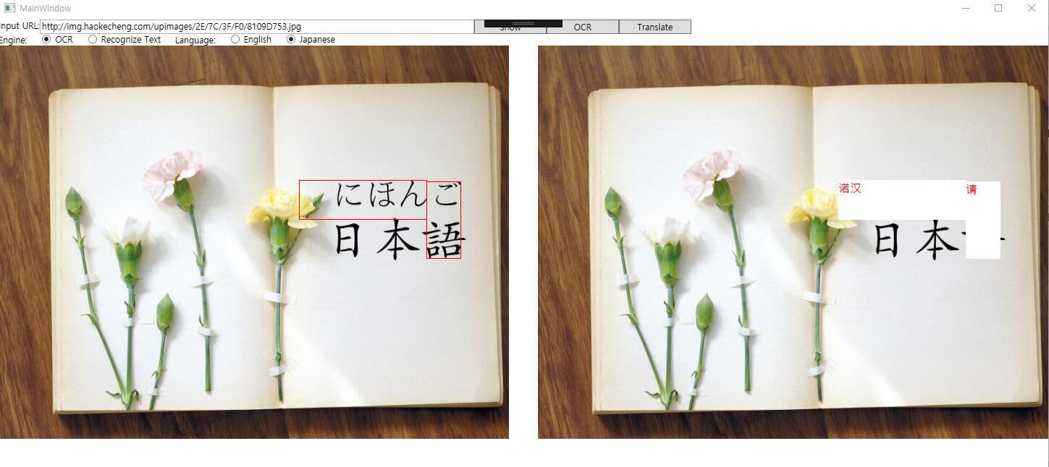
Translate BUTTON

Slide 20
4.
Result analysis
Upload the project to Microsoft azure's Web service.

Slide 21
THANK YOU
팀: 손홈/201910579
상매/201910578

